Slide 1
Anesthetic Monitoring
Clinical monitoring
Pulseoxymetry
Capnography
Non invasive Blood pressure
ECG
Peripheral nerve stimulators
Volatile / gas analyser & anaesthesia depth
Temperature monitoring
√
√
√
√
√

Slide 2
Peripheral nerve stimulators
What information does it give?
Depth of neuromuscular block (paralysis)
Degree of reversibility
Type of neuromuscular block
(1) If the surgeons feel the abdomen is ‘tight’, does the paralysis need topping up?
(2) If pancuronium was given 25 minutes ago, is it okay to reverse the block yet?
(3) After several doses of suxamethonium, has the block started to behave like a non-depolarising block?

Slide 3
Peripheral nerve stimulators
Components
on/off light
stimulation light
40
60
“train of four”
20
80 mA
TOF
current setting
“double burst stimulation”
DBS
negative connection
Tetany
on/off control
“tetany”
1 Hz
stimulation every second
positive connection
buttons

Slide 4
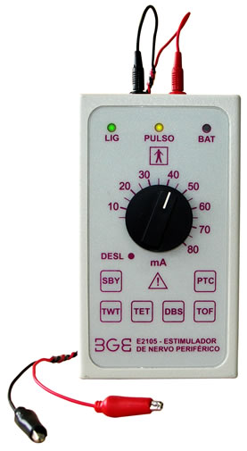
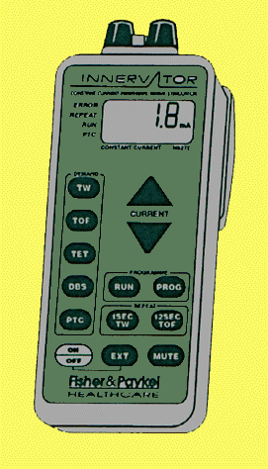
Peripheral nerve stimulators
Examples

Slide 5
Peripheral nerve stimulators
Settings
“train of four”
four 200microsec twitches over 1.5s
“double burst stimulation”
three 200microsec twitches over 40ms, followed by another three 750ms later
“tetany”
repeated 200microsec twitches every 20ms for 5 sec
1 Hz stimulation
single 200microsec twitches every 1s

Slide 6
Peripheral nerve stimulators
Settings
“train of four”
four 200microsec twitches over 1.5s
0
0.5
1
1.5
s
“double burst stimulation”
three 200microsec twitches over 40ms, followed by another three 750ms later
0
40
750
ms
repeated 200microsec twitches every 20ms for 5 sec
“tetany”
0
20
100
200
300
ms
1 Hz stimulation
200microsec twitches every 1s
0
1
2
3
s
NOTE: different time scales

Slide 7
Peripheral nerve stimulators
How does it work?
ECG ‘dots’ are placed:
1 over a nerve
1 away from nerve
**
Negative (black) connection attached to dot over nerve
Positive connection to other dot
‘Dial up’ current setting – typically 40 - 60 mA
Turn on
Relevant stimulation button pressed
Light flashes with each stimulation
Muscle response observed
** suitable nerves:
facial n (above parotid)
ulnar n (at wrist)
common peroneal n (just below knee)

Slide 8
Peripheral nerve stimulators
How does it work? (cont.)
Supra-maximal current → all motor fibres of nerve are stimulated
Muscle response is observed = test of neuromuscular junction
e.g.
facial n → forehead twitch
ulnar n → medial finger twitches
Normal:
Consistent size twitches even with repeated stimulation
Some increase in twitch size during tetany, but not after
TOF response
Tetanic response
TOF response
1 Hz twitches

Slide 9
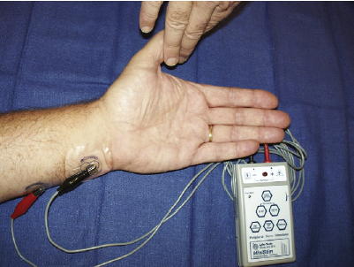
Fig-A nerve stimulator used clinically to assess neuromuscular function
subjectively (visually or tactilely).

Slide 10
Peripheral nerve stimulators
With depolarising block (suxamethonium)
Initial response after full dose:
i.e. fully paralysed
TOF response
Tetanic response
TOF response
1 Hz twitches
As effect “wears off” :
Small twitches even with repeated stimulation
Slight increase in twitch size during tetany, but not after
TOF response
Tetanic response
TOF response
1 Hz twitches
Eventually; response returns to normal

Slide 11
Peripheral nerve stimulators
With non-depolarising block (vecuronium or pancuronium)
Initial response after full dose:
i.e. fully paralysed
TOF response
Tetanic response
TOF response
1 Hz twitches
As effect first starts to “wear off” :
Some response during tetany, but not maintained
“post-tetanic potentiation”
Absent twitches with TOF stimulation
(not maintained)
TOF response
Tetanic response
TOF response
1 Hz twitches

Slide 12
Peripheral nerve stimulators
With non-depolarising block (cont.)
With further time for effect to ‘wear off’ :
Some twitches with TOF (even without tetany)
Some twitches at 1 Hz
Obvious ‘fade’ between the 2 bursts of DBS
TOF response
1 Hz twitches
DBS response
So, when is it okay to reverse the block (i.e. give neostigmine)?
Most anaesthetists would give reversal once ≥ 3 twitches are seen during TOF stimulation (without tetany)

Slide 13
Peripheral nerve stimulators
With non-depolarising block (cont.)
So, how much is the neuromuscular junction still blocked?
Number of twitches with TOF
Proportion of NMJ receptors blocked
Assuming the machine is working
0
>90%
1
90%
2
80%
3
75%
4
≤ 70%
Even if all 4 twitches are seen, there may be significant residual neuromuscular block – it is still important to reverse paralysis

Slide 14
Peripheral nerve stimulators
What do you see with repeated doses of suxamethonium?
Single dose of suxamethonium → typical depolarising block
Multiple doses of suxamethonium → block like those from non-depolarising drugs
Post-tetanic potentiation
Fade
BUT this is not amenable to reversal with neostigmine

Slide 15
Peripheral nerve stimulators
What are the benefits?
Indicates when further paralysis is required
Indicates when neostigmine will safely reverse paralysis
Number of twitches after tetanic stimulation gives some idea of how long paralysis will take to wear off (requires experience)
What are the limitations?
TOF stimulation can be difficult to judge (hence DBS used)
4 twitches with TOF does NOT mean reversal is not required
Different muscles may recover at different rates, so facial twitches do not mean diaphragm is necessarily recovering

Slide 16
Peripheral nerve stimulators
The clinical benefits
(1) Indicates when further paralysis is required
This can save unnecessary repeat does of non-depolarising blockers
(even if the surgeon asks for it, the patient may still be paralysed!)
(2) Indicates when neostigmine will safely reverse paralysis
If reversal given too soon;
Poor respiratory effort
Hypoventilation
Risk of aspiration
Very unpleasant
Just because patient is seen to breath does NOT mean that paralysis is fully reversed
Useful clinical markers of full reversal:
Head raise for 5s
Firm hand squeeze 10s
Good cough & maintaining normal ETCO₂ for a few minutes

Slide 17
Anesthetic Monitoring
Clinical monitoring
Pulseoxymetry
Capnography
Non invasive Blood pressure
ECG
Peripheral nerve stimulators
Volatile / gas analyser & anaesthesia depth
Temperature monitoring
Documentation
√
√
√
√
√
√

Slide 18
Oxygen concentration analysers
What information does it give?
The oxygen concentration in gas mixture delivered to patient
Why is this important?
Essential to know concentration of oxygen being delivered to patient to prevent ventilation with hypoxic gas mixture
No way of accurately knowing oxygen concentration without measuring it

Slide 19
Oxygen concentration analysers
Reasons oxygen delivery to patient may not be what you expect
Maximum concentration of oxygen produced by oxygen concentrator?
Is oxygen concentrator working properly?
Is there a leak in oxygen piping behind the wall?
Has the wall oxygen probe accidentally been connected to wrong socket?
Is there a problem with the anaesthetic machine (eg. cracked rotameter?)
Is there a leak in the circuit?
How much oxygen is being consumed by the patient?

Slide 20
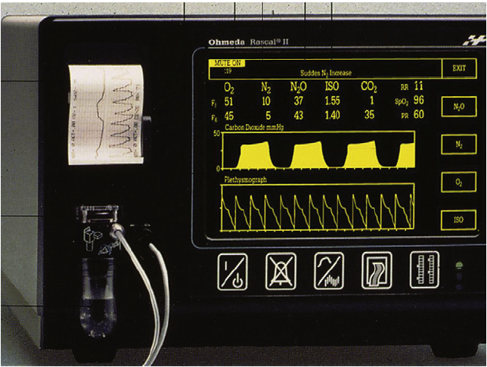
Fig-inspired and expired gas analyzer

Slide 21
Monitoring anaesthesia depth clinically

Slide 22
Most Reliable Signs of Anesthetic Depth initially
Gross purposeful movement
Reflex movement in response to stimulation
Immediate hemodynamic response to stimulation; sudden marked increase in heart rate or blood pressure.
Immediate respiratory response to stimulation; sudden marked increase in respiratory rate or depth of breathing.
Response to stimulation prior to actual incision (such as clipping, surgical preparation, drape, clamps).

Slide 23
Reliable Signs of Anesthetic Depth
History of vaporizer setting
Muscle tone (e.g. jaw tone)
Pupillary light reflex
Palpebral reflex
Corneal reflex
Moist cornea (lacrimination or tears)
Position of the eyeball
Notes:
Eyelid-palpebral

Slide 24
Less Reliable Signs of Anesthetic Depth
Heart Rate: may increase or decrease with increased depth of anesthetic plane. At deep plane it may accompany bradycardia, but also severe cardiovascular depression may increase heart rate to compensate for fall in stroke volume. (differentiate from noxious stimulation induced increase; less marked in changes).
Respiration rate: may increase or decrease with deepening anesthesia. At deep plane, it may accompany apnea, but also may initiate a rapid shallow breath following a period of apnea as a compensation. (similar to hemodynamics, fall in tidal volume tends to increase respiration rate.)
Blood pressure is similar to heart rate, but probably more reliable. In general, the volatile anesthetics; halothane, isoflurane, sevoflurane, and desflurane produce a dose-dependent decrease in arterial blood pressure and many anesthetists use this depression to assess the depth of anesthesia.

Slide 25
Thermometers
What information do they give?
Peripheral / skin or core temperature; often as constant reading
If both are measured, the discrepancy gives an indication of peripheral perfusion
Why is this important?
Almost all patients lose heat during a general anaesthetic
Cool patients wake slower
Cool blood clots less effectively → more blood loss
Hypothermia increases wound infection and prolongs paralysis
Hyperthermic patients vasodilate → may affect BP
Marked deviations from 37°C are dangerous (e.g. myocardial ischaemia and arrhythmias)
Fever may indicate an underlying inflammatory response (e.g.sepsis)
Rapid rise in temperature may signal malignant hyperthermia#

Slide 26
Thermometers
Sites for measurement of core temperature
Ear drum
Accurately reflects brain temperature; usually single readings
Oesophageal
Lower 1/3 accurately reflects core temperature
Nasal
If placed at back of nasal cavity reflects hypothalamic temperature (in theory), although any gas flow will alter this
Bladder
With normal urine output, represents core temperature
Rectal
Often slow to respond and may exceed core temperature
Other sites for peripheral temperature
Skin
Axilla
Best site for detecting malignant hyperthermia

Slide 27
Anesthetic Monitoring
Clinical monitoring
Pulseoxymetry
Capnography
Non invasive Blood pressure
ECG
Peripheral nerve stimulators
Volatile / gas analyser & anaesthesia depth
Temperature monitoring
Documentation
√
√
√
√
√
√
√
√

Slide 28
Finally
There is no substitute for substitute for a trained anesthetist to monitor a patient !!!

Slide 29
end

